Slide 1
Water Pumps Predictions
Tanzania

Slide 2

What is the Problem?
Predicting Pumps
Functional
Not Functional
Functional but needs repair
Notes:
It’s on Data Driven and the data is collected of Ministry of Water Tanzania and Taffaria Platform

Slide 3
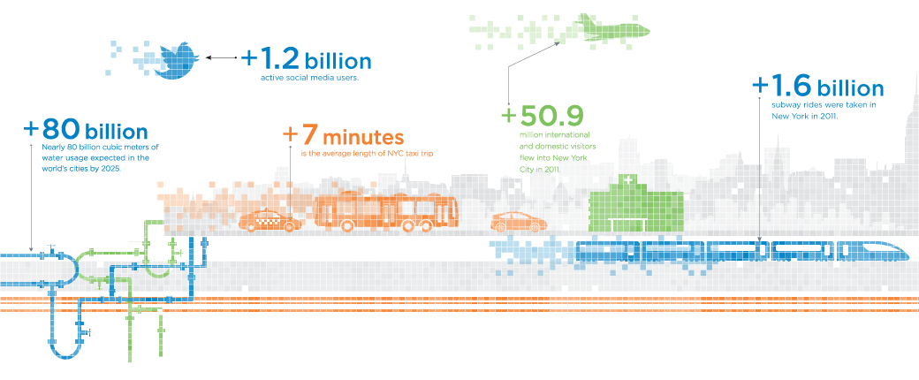
Why this Project?
Notes:
Want to get into this NYU grad school...

Slide 4
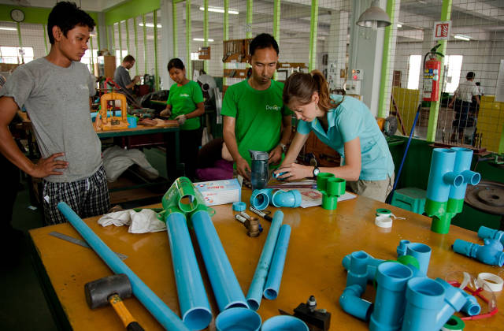
Similar Project going on ...
Notes:
Proximity Design..

Slide 5
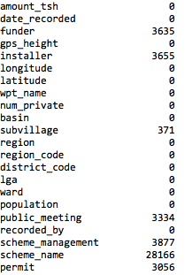
Cleaning Data
Mostly clean
Here is the shape
(59400, 39), each row is water point..
funder, installer, region, scheme_mangement, management, water point_type.. etc
Same goes for indep variables with 1 column of Functional, Not Functional..etc
There were a couple of NAs…

Slide 6
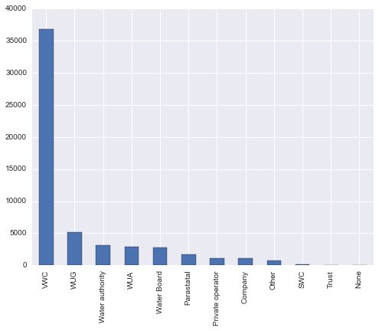
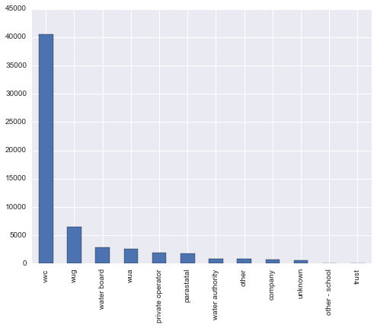
Some Duplicates Categorical Variables
Scheme Management
Management
Notes:
Scheme Management vs Management
Forget to label the graph

Slide 7
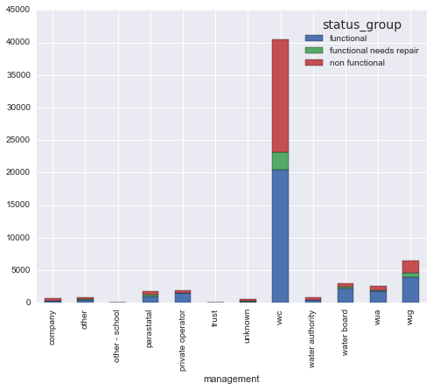
What is VWC?
Notes:
Coming from a developing country myself, I have a suspicion that management (public or private) could be relatively weak.
Turns out most of the pumps are managed by VWC. Reading the literature a little bit. VWC stands for Village Water Committee and it’s part of village government and a remanent of the socialist era where water is supposed to be “Free” .. before they realize in 1996, it’s failing.. and encouraged private ownership or public partnership.. yidiyada.. but VWC still is a dominant player with the government trying to transform it to a regulatory body..

Slide 8
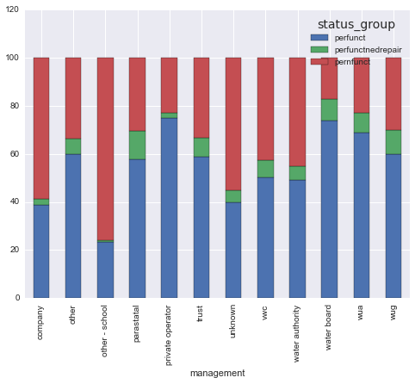
So the Private Management Wins?
Notes:
The Winners: Private Operator, Water Board, WUA, WUG,
The Losers: Other- School, Unknown, Water Authority, VWC
We are dividing so that we can see further differences between these two based on other variables

Slide 9
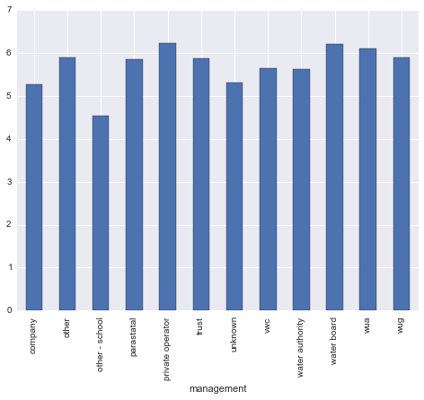
Log base 2… just for kicks
Notes:
Just seeing if any management is performing 2 times better than government or so some people would like to prove
The scale is not log scale. U have to imagine multiples of 2 or Exponents

Slide 10
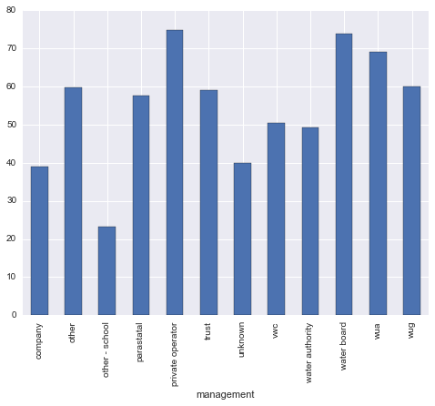
Hmm.. Let’s just focus on success rate
Notes:
I think I will not be able to keep track of all three of them and find significance for each.
Why not failure sb might ask? Well, simply I like the sound of it.

Slide 11
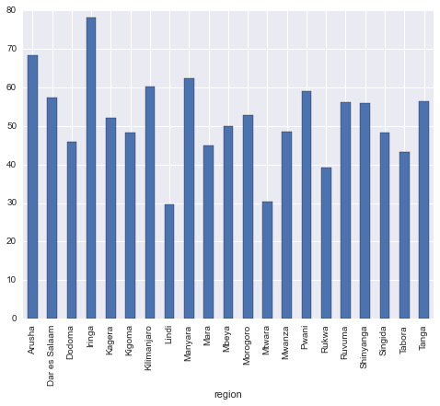
Is Alaska more prosperous than California?
Notes:
Let’s check regions because I think Alaska is full of Snow and California has the sun.. So, some regions might be more prosperous n they might have the funds to buy better equipment, fix it quicker or has better governmental support
The Winning States are: Iringa, Arusha, Manyara
The Losing States are: Lindi, Mtwara, Rukwa

Slide 12
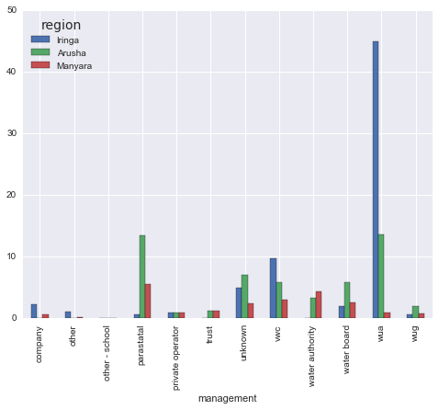
S.Regions and Management Concentration
Notes:
So we want to see if the success operators concentrate in successful regions
Iringa - WUA, VWC, Unknown
Arusha - Parastatal, WUA, Unknown
Manyara - Parastatal, Water Authority, Unknown
Not too bad. WUA in two regions play a prominent role is one of the more successful one. Unknown is disturbing fudging the data.
We do have Water authority which is one of the less successful management taking a more significant share in a more successful state.
Parastatal.. which I have no idea also quite a role

Slide 13
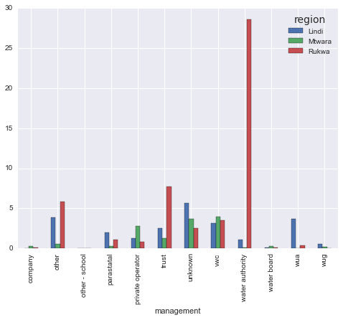
Un Region and Management Concentration
Notes:
As sort of expected.. Water Authority plays quite a prominent role in Rukwa
VWC is slightly more prominent in Mtwara
Surprisingly, Private Operator (the most successful pump management) plays quite a role in Mtwara
Unknown is prominent for Lindi.. still VWC commands a relatively strong presence though it looks to be mostly well-distributed

Slide 14
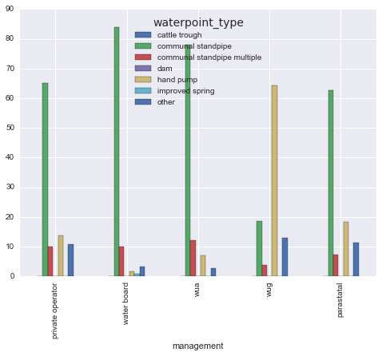
Type of Equipment across Suc : Management
Notes:
Hmm what could make water pumps break down? Could be the type of the pump? Some are more prone to failure than others… or higher maintenance cost etc
Let’s check what equipment are the most operators using
It turns out Communal Standpipe, Communal standpipe multiple and hand pump are the most prominently used across the handful of successful Water Management/Operators

Slide 15
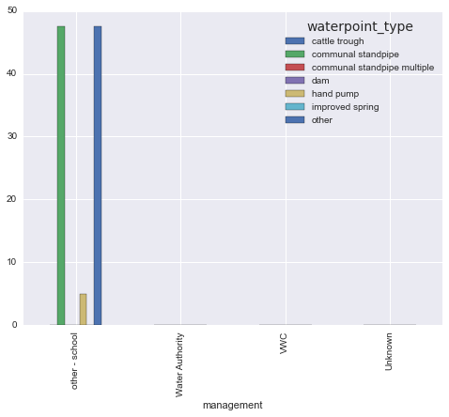
Type of Equipment Across UnSuccess Mgmt
Notes:
Communal Stand pipes still play a role.. but equally is Cattle Trough prominent
The rest is NAN.. ..

Slide 16
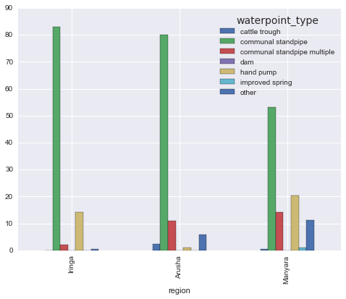
Can we double back and check across S.Regions?
Notes:
There we go .. Communal Standpipe and Hand pumps seem to play quite a role

Slide 17
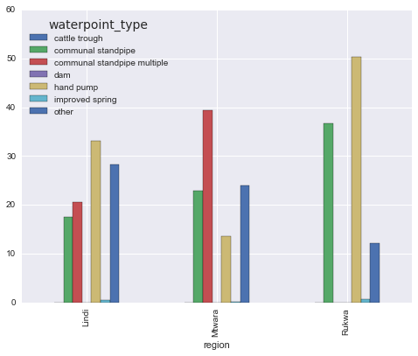
How about the underperforming regions?
Notes:
hmm.. Communal standpipe & hand pump still plays quite a role with the green and brown and yellow but here comes
the category “Other”.. so those standpipes and handpumps are less prominent in less successful regions?

Slide 18
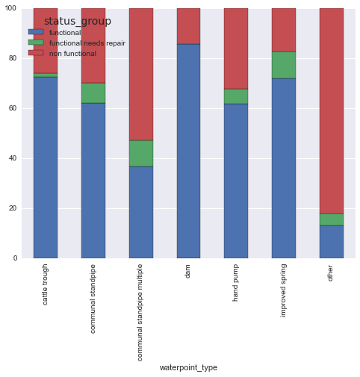

You know there is something going on...
Notes:
You know there is something on.. the success rate is not that high for standpipe or handpump compared to dam or cattle trough or improved spring…
Pretty sure Standpipe is the most commonly found thing..
But the other thing to notice is the OTHER! The Other category has very low success rate and we don’t what that is.. what’s their intentions are.. whatever!

Slide 19
So what is the model to use?
GIVE ME A BREAK. No Idea yet!

Slide 20
Future Steps
More data exploration
Want to check the unsuccessful rate
Maybe Pair it with Installer or Length of the equipment
Want to draw some regression lines with dummy variables
If I were to find more data
I want to calculate the distance of these water pumps from urban centers (roads paved) etc and see if it plays a role
I need to put some qualifier on Urban Centers and Roads paved but my hunch is more remote regions would have Sucky Water Pumps etc
GDP/capita of the Region?
Thanks!
Victor, Alex.. :) :) Much much appreciated

